Slide 1
Data 205 Lecture 12
Measuring Association with Categorical Variables
Yinxian Zhang
Assistant Professor of Sociology
Queens College, CUNY

Slide 2
Today’s Content
Bivariate Association
direction
strength
statistical significance
Bivariate Categorical Analysis
contingency tables
Hypothesis Testing for Bivariate Categorical Analysis
Chi-squared test
Notes:
Transition week.

Slide 3
The Learning Commons, an academic support center, offers support for the following DATA courses:
DATA 205
DATA R Programming
DATA SQL Programming
DATA 306
DATA 333
Students can make appointments directly on this site: https://mywco.com/qclc
Questions? Email LCommons@qc.cuny.edu

Slide 5
Recap
population
sampling
Sample
We will introduce bivariate analysis today!
statistical inference
parameter: characteristics of the population
descriptive statistics: characteristics of the sample
inferential statistics: predictions about the population

Slide 6
Getting started with bivariate analysis
So far, we have only looked at the characteristics of a single variable , including its frequency distribution and summary statistics like the mean or percentage in a sample, as well as using sample data to predict what this variable looks like in the population (e.g., using the sample mean to predict the population mean)
We call it univariate analysis.
Next step: to explore the association between two variables in a sample and make inferences about their relationship in the population. This is called bivariate analysis.

Slide 7
A quick review of independent (X) and dependent (Y) variables
In a theory/hypothesis:
Y: the effect. The outcome to be explained [the dependent/outcome variable]
X (X1, X2, X2…): the causes. The inherent characteristics that explain/predict the outcome or effect [the independent/explanatory variables]
Z (Z1, Z2, Z3…): thing(s) that may also explain the outcomes (think of them as the alternative independent variables) but not the focus of your research (so you want to control them) [control variables]

Slide 8
What is association?
An association is a systematic pattern that exists between variables:
  The values of one variable tend to go with the values of the other.
  This pattern can be measured and quantified.
  In other words, the value of one variable give information about the value of the other.
For instance:
Two categorical variables: Is there an association between marital status and happiness?
  E.g. married people tend to be happier?
Two numerical variables: Is income associated with years of education?
  E.g.: the longer years of education, the higher income?

Slide 9
Association ≠ Causation
Causation
A change in X produces/causes a change in Y
Association
A change in X coincides with a change in Y

Slide 10
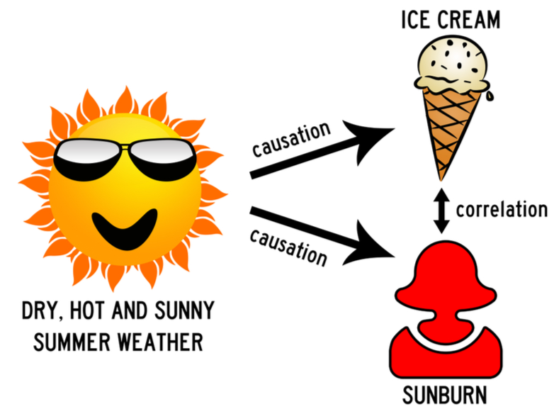
Logic of Causal Order
Cause and effect should occur close together.
The cause should come before the effect.
When the cause is absent, the effect should be absent.
When the cause is present, the effect should be present.

Slide 11
Association v.s. Correlation
In everyday language:
Association and correlation are used interchangeably.
Technically, however:
Association is a general relationship: one variable provides information about another.
Correlation is more specific: it measures the strength of association between two variables.
Read more about the two in this Nature article: https://www.nature.com/articles/nmeth.3587

Slide 13
Three Measures of Association
Bivariate analysis studies the association between the dependent/outcome variable (Y) and the independent/explanatory (X) variable. Three important measures are:
Direction: do Y and X go in the same direction? (e.g., increase in X coincides with increase in Y)
Strength: to what extent does Y go with X? (e.g. strong or weak connection?)
Statistical significance: does the association we see in a sample still hold true in the population?
There are many techniques for measuring associations – which method to use depends on the levels of measurement:
  Bivariate categorical data
  Bivariate numerical data
  Categorical and numerical variables -- not the focus of this course

Slide 14
Bivariate Analysis of Categorical Data
For categorical variables (primarily nominal variables, but also apply to ordinal variables), the three measures of association are:
Direction/pattern: contingency tables
Strength:
  Roughly, we will use a rule-of-thumb estimate: percent % point difference
  Precisely, relative risk (risk ratio) or odds ratio statistics (content for advanced courses)
Statistical significance: Chi-squared tests

Slide 15
1. Direction/Pattern of the Association
For categorical variables, we use contingency table to describe the pattern of the bivariate association.
A contingency table displays the joint frequency distribution of two categorical variables:
  i.e., the number of observations falling under different combinations of the possible categories.
  In other words, the table shows the distribution of one variable contingent on the other.
Contingency table of sex and housework (N = 200)
A contingency table is also called cross tabulations or cross-tabs.
 | Male | Female | Total
Housework (yes) | 20 | 50 | 70
Housework (no) | 80 | 50 | 130
Total | 100 | 100 | 200

Slide 16
Column and row percentages
Recap: percentage = (num of obs in one category / total num of obs) * 100%
Example:
Total N = 200
Num of males = 100
Percentage of males = 100/200 * 100% = 0.5*100% = 50%
In a contingency table, there are two ways to calculate percentages, either along columns or along rows.
Contingency table of sex and housework
 | Male | Female | Total
Housework (yes) | 20 (20%) | 50 (50%) | 70
Housework (no) | 80 (80%) | 50 (50%) | 130
Total | 100 (100%) | 100 (100%) | 200
Column percentages = (cell count divided by the column total) x 100%
In this table, Col % shows the distribution of housework, contingent (conditional) on biological sex

Slide 17
Column and row percentages
Recap: percentage = (num of obs in one category / total num of obs) * 100%
Example:
Total N = 200
Num of males = 100
Percentage of males = 100/200 * 100% = 0.5*100% = 50%
In a contingency table, there are two ways to calculate percentages, either along columns or along rows.
Contingency table of sex and housework
 | Male | Female | Total
Housework (yes) | 20 (28.6%) | 50 (71.4%) | 70 (100%)
Housework (no) | 80 (61.5%) | 50 (38.5%) | 130 (100%)
Total | 100 (50%) | 100 (50%) | 200 (100%)
Row percentages = (cell count divided by the row total) x 100%
In this table, Row % shows the distribution of sex, contingent (conditional) on housework
Notes:
80/130 * 100% = 61.5%
50/130 * 100% = 38.5%

Slide 18
Which way is better?
It depends on your X and Y.
Which variable is your independent variable X (causes, inherent characteristics, explanatory factors)? Which variable is your dependent variable Y (outcomes, effects, things to be explained)?
Then look for your X:
- if X is in the row (horizontal), use row percentage; each row should add up to 100%
- if X is in the column (vertical), use column percentage; each col should add up to 100%
In our example: biological sex v.s. housework
X: biological sex
Y: housework
Since sex is in the column, so column percentages is more appropriate for this example.
Each column should sum up to 100% → all males = 100% & all females = 100%
Identifying X and Y is important, and the table layout does NOT matter.
If we put “sex” in the row, we will use row percentages instead.

Slide 19
How to analyze a contingency table?
Step 1: Identify X and Y in the contingency table (Which is the cause, and which is the effect?)
Step 2: Depend on where X is (in the row or in the column?), calculate the row or column percentages along X. Each category of X should add up to 100%.
Step 3: Compare the percentages across the categories of X.
Contingency table of sex and housework
 | Male | Female | Total
Housework (yes) | 20 (20%) | 50 (50%) | 70 (35%)
Housework (no) | 80 (80%) | 50 (50%) | 130 (65%)
Total | 100 (100%) | 100 (100%) | 200 (100%)
Who is more likely to do housework? Female
50% - 20% = 30% points difference
Who is more likely NOT to do housework? Male
80% - 50% = 30% points difference

Slide 20
How to interpret the results?
Rule of thumb (not a precise measure of association strength!)
0-9 percentage points difference = little to no association
10-30 percentage points difference = moderate association
31+ percentage points difference = strong association
To precisely measure the strength of association, we need odds ratio or risk ratio statistics (covered in advanced stat courses)
Among all the males, 20% did housework yesterday.
Among all the females, 50% did housework yesterday.
There is a 30% points difference.
Interpretation:
There is a moderate to strong association between biological sex and doing housework. (strength)
Females are more likely to do housework than males. (pattern)

Slide 21
The same rules apply to contingency tables with more categories/ordinal variables
Compare % across categories of X (education): more education is associated with higher income
Notes:
Both columns add up to 100%, you can make comparisons across the columns.

Slide 23
2. The (Precise) Strength of The Association
A contingency table alone simply shows the existence (or lack thereof) of an association between two categorical variables in the sample.
We don’t know:
- How strong is this association precisely? (percentage points difference is only a rough estimate)
Odds ratios, relative risk, etc. (content for more advanced statistical courses).

Slide 24
3. The Significance of The Association
We also don’t know:
Does this bivariate categorical association exist in the population as well?
In other words, the pattern we observe in a sample could be just fluke. Does it still hold on the population level?
To make inferences about a population based on sample data, we need hypothesis testing.

Slide 25
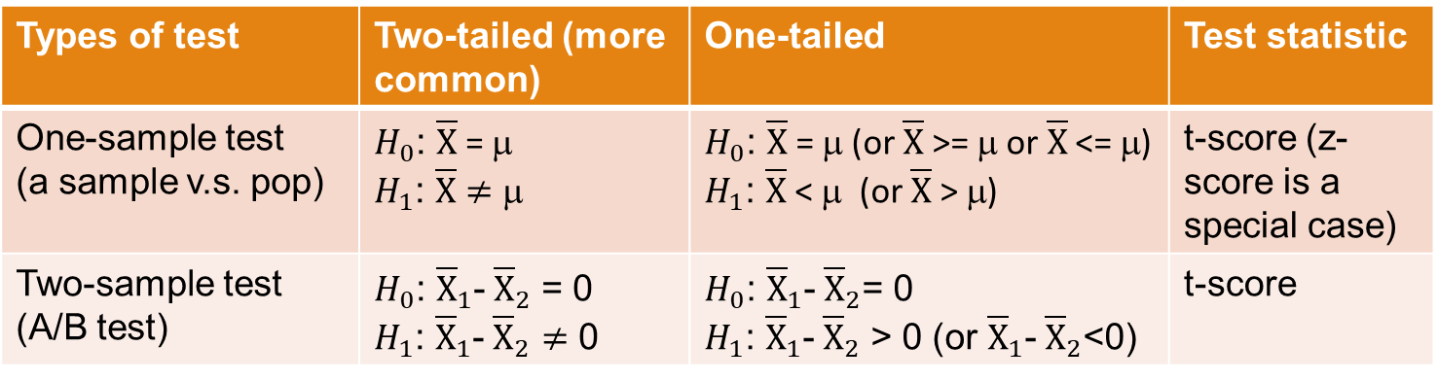
Quick Recap on Hypothesis Testing
Different types of hypothesis testing:
Types of test | Two-tailed (more common) | One-tailed | Test statistic
One-sample test (a sample v.s. pop) | $H_{0}$: $\overline{X}$= μ $H_{1}$: $\overline{X}≠$ μ | $H_{0}$: $\overline{X}$= μ (or $\overline{X}$ >= μ or $\overline{X}$ <= μ) $H_{1}$: $\overline{X}$< μ (or $\overline{X}$> μ) | t-score (z-score is a special case)
Two-sample test (A/B test) | $H_{0}$: ${\overline{X}}_{1}$-${\overline{X}}_{2}$ = 0 $H_{1}$: ${\overline{X}}_{1}$-${\overline{X}}_{2}≠$ 0 | $H_{0}$: ${\overline{X}}_{1}$-${\overline{X}}_{2}$= 0 $H_{1}$: ${\overline{X}}_{1}$-${\overline{X}}_{2}$ > 0 (or ${\overline{X}}_{1}$-${\overline{X}}_{2}$<0) | t-score

Slide 26
Quick Recap on Hypothesis Testing
The general procedure of all types of hypothesis testing (by hand, or with R)
Construct the null hypothesis (H0) and the alternative hypothesis (H1)
Get the test statistic
  Do it by hand: calculate the Z-score or t-score of the sample mean/proportion.
  Do it with R: look for the p-value.
Make the comparison:
  Do it by hand: compare calculated z-/t-scores to the critical value(s), e.g. [-1.96,1.96], +/-1.65, +/-2.33, depending on the confidence level and whether it’s one- or two-tailed.
  Do it with R: compare the p-value with the alpha level: 0.05 or 0.01.
Make a decision based on the comparison:
  Test statistic falls outside of the critical value interval (falls in rejection region) or p < 0.05 (or 0.01): reject H0
  Test statistic falls within the critical value interval or p >= 0.05 (or 0.01): fail to reject H0

Slide 27
Hypothesis Testing for Bivariate Association
Can we use sample data to predict whether a bivariate categorical association exists on the population level?
YES!
To answer this question, we introduce a new type of hypothesis testing: Chi-squared tests (for bivariate categorical associations only).

Slide 28

The Chi-Squared Test ${\text{(}\text{χ}}^{2})$
Chi-squared test is a technique of hypothesis testing which checks whether an association between two categorical variables observed in a contingency table based on a sample also exists in the population.
Formally, the chi-squared test is a test of whether the categorical variables in the table are independent of each other (i.e., unrelated) in the population, and the chance of independence is calculated as a probability (p-value).
  p-value < 0.05 (or 0.01): the probability of independence is too low, and we conclude that the two variables are associated in the population.
  p-value > 0.05 (or 0.01): the probability of independence is high enough, and we conclude that the two variables are independent (not associated / not influence each other) in the population.

Slide 29
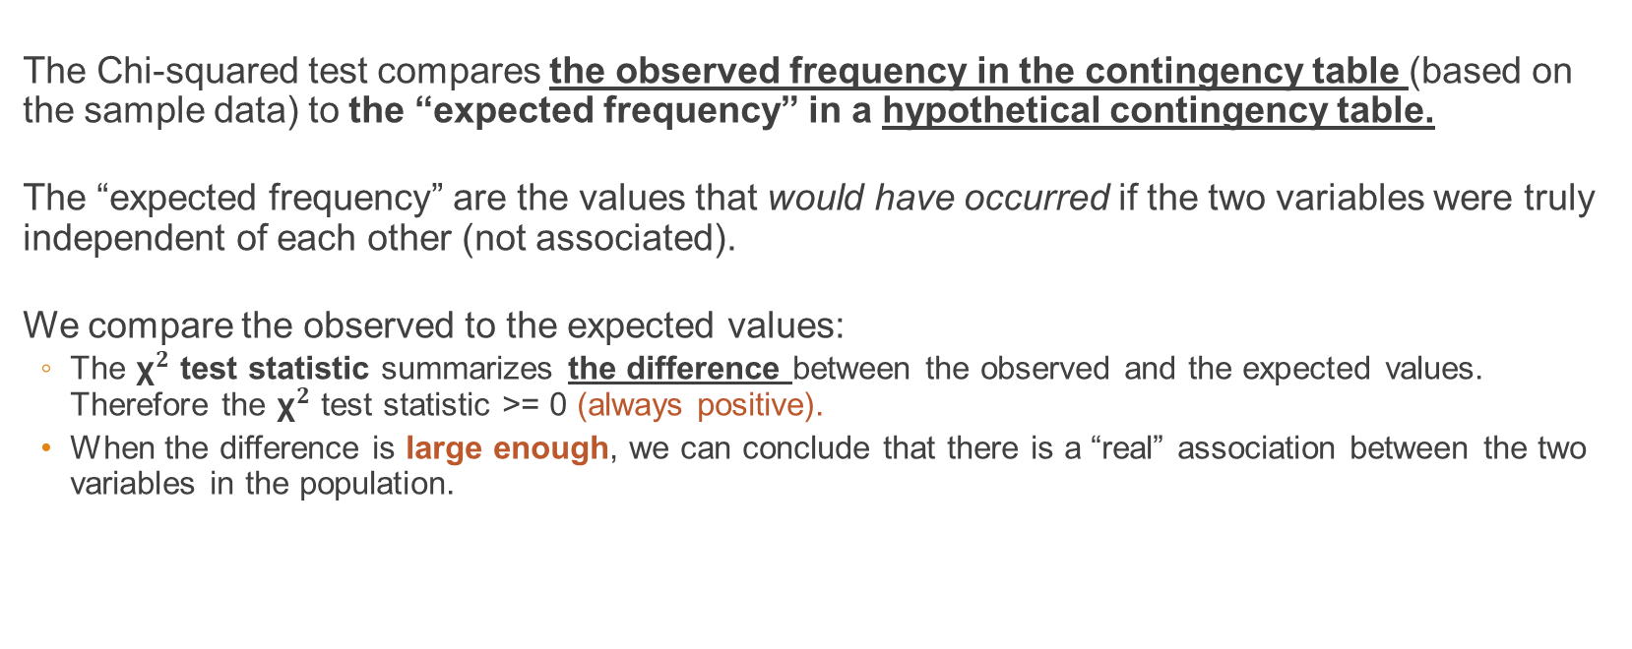
The ${\text{χ}}^{2}$ Test: How does it work, in a nutshell
The Chi-squared test compares the observed frequency in the contingency table (based on the sample data) to the “expected frequency” in a hypothetical contingency table.
The “expected frequency” are the values that would have occurred if the two variables were truly independent of each other (not associated).
We compare the observed to the expected values:
  The ${\text{χ}}^{2}$ test statistic summarizes the difference between the observed and the expected values. Therefore the ${\text{χ}}^{2}$ test statistic >= 0 (always positive).
  When the difference is large enough, we can conclude that there is a “real” association between the two variables in the population.

Slide 30
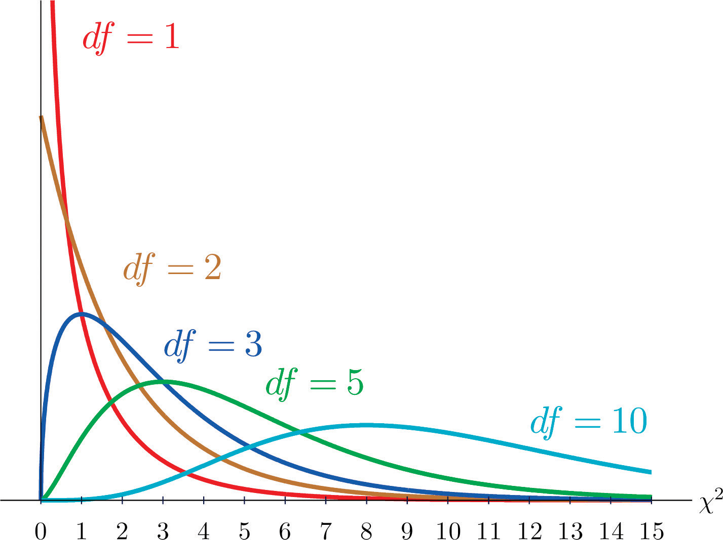
The ${\text{χ}}^{2}$ Test: How does it work, in a nutshell
$$χ^{2}=\sum{\frac{(fo−fe)^{2}}{fe}}$$
f₀ = observed frequency of each cell, i.e., the table we made.
f_{e} = expected frequency of each cell, assuming no association.
Degrees of Freedom (df) =
(# of rows – 1) (# of columns – 1)

Slide 31
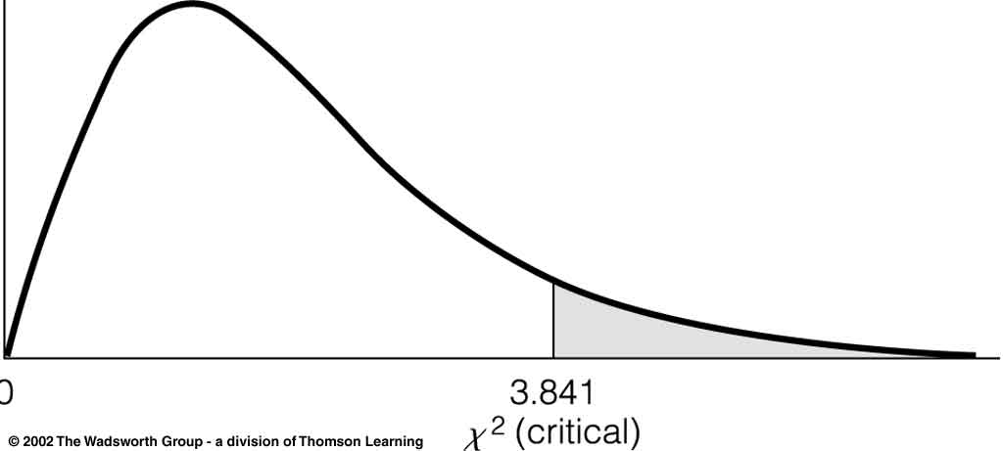
The ${\text{χ}}^{2}$ Test: How does it work, in a nutshell
Chi-squared test is a one-tailed test to see if the difference between the observed and the expected frequency is large enough (“greater than” a critical value):
Alpha = 5% or 0.05
95% confidence interval
  Once we calculate the the ${\text{χ}}^{2}$ test statistic, we can compare it to the critical value found on a ${\text{χ}}^{2}$ table.

Slide 32
4 Steps of Chi-squared Tests, with R
(1) Construct Null Hypothesis (H0) and Alternative Hypothesis (H1).
  H₀: There is no relationship between the two variables in the population, i.e. they are independent.
  H₁: There is an association between the two variables in the population, i.e. they are not independent.
(2) Get the p-value from the R output.
  P-value in chi2 test = the probability of independence.
(3) Compare p-value to the alpha level.
(4) Make a decision about whether to reject H0 based on the p-value.
  P-value < 0.05 (or 0.01): reject H0, conclude that the two variables are associated.
  P-value >= 0.05 (or 0.01): failed to reject H0, conclude that the two variables are independent.
  We will use R for chi-squared tests.

Slide 33
An example
Is biological sex associated with the habit of doing housework? In other words, is there a sex difference in terms of whether people would like to do housework?
Please test the association at the 0.05 significance level.
X = ?
Y = ?
Use row or col percentage?
Contingency table of sex and housework
 | Male | Female | Total
Housework (yes) | 20 | 50 | 70
Housework (no) | 80 | 50 | 130
Total | 100 | 100 | 200

Slide 34
First, analyze the contingency table
X = biological sex
Y = housework
X (sex) is in the column, so we use column percentage.
Is there an association between biological sex and doing housework? → describe the association
Pattern: Female is more likely to do housework.
Strength (roughly, by rule of thumb): 50% - 20% = 30% difference → the strength is moderate to strong
Contingency table of sex and housework
 | Male | Female | Total
Housework (yes) | 20 (20%) | 50 (50%) | 70 (35%)
Housework (no) | 80 (80%) | 50 (50%) | 130 (65%)
Total | 100 (100%) | 100 (100%) | 200 (100%)

Slide 35
Then, use R for a chi-squared test
>
> chisq.test(df$housework, df$sex, correct=FALSE)
Pearson's Chi-squared test
data: df$housework and df$sex
X-squared = 19.78, df = 1, p-value = 8.688e-06
Note that R does not generate H0 and H1 for chi-squared test. It’s your responsibility.
The p-value is 8.688e-06
How to interpret?

Slide 36
Together, the 4 steps of hypothesis testing
(1) Construct Null Hypothesis (H0) and Alternative Hypothesis (H1).
  H₀: There is no relationship between sex and the habit of doing housework in the population, i.e. they are independent.
  H₁: There is an association between sex and the habit of doing housework in the population, i.e. they are not independent.
(2) Get the p-value from R outputs.
p-value = 0.000008688
(3) Compare p-value to the alpha level of 0.05.
  0.00008688 << 0.05
(4) Make a decision about whether to reject H0 based on the p-value.
  P-value < 0.05: reject H0.
  Based on the p-value (0.0000087), we reject H0 and conclude that there is a statistically significant association between sex and the habit of doing housework in the population.

Slide 37
Interpret the three measures of the association
Our sample suggests that there is an association between sex and the habit of doing housework:
1. Pattern: Females are more likely to do housework than males.
2. Strength: The strength of the association is moderate to strong.
3. Significance: A Chi-squared test shows that the association is statistically significant in the population.
Compare Percentages: 20% Males v.s. 50% of Females did housework
Size of Difference between Percentages = 30% points
Chi-square Test: P-value < 0.05, Rejected Null Hypothesis

Slide 38
Finally, write a summary
Template: strength + pattern + significance
Our sample data indicates that there is a moderate to strong association [strength] between sex and the habit of doing housework. Particularly, females are more likely to do housework than males [pattern]. A chi-squared test shows that this association is statistically significant in the population at the 0.05 significance level, with a p-value of 0.0000087 [significance].

Slide 40
Recap: Bivariate Categorical Analysis
Association between two variables | Direction/pattern of the association | Strength of the association | Significance of the association
Two categorical variables | Contingency table - which one is X and which is Y? - Calculate row or col percentage along X - Compare % point difference across X categories | Roughly: % point difference Precisely: Odds ratio, relative risks, etc (advanced stats course) | Chi-squared test - p-value >= 0.05: no association - p-value < 0.05: significant association

Slide 41
Assignment
BrightSpace Assignment “HW9”
- 5 points total.
Deadline: May 3, Sunday, 11:59 pm
Submit to BrightSpace. Email submissions not accepted.

